Slide 1


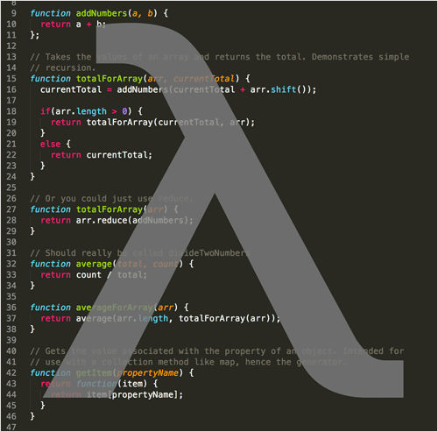

Stream API
Working with the Stream API
Advanced Java
SoftUni Team
SoftUni Team
Technical Trainers
Technical Trainers
Software University
Software University
http://softuni.bg

Slide 2

Table of Contents
Stream<T> Class
Types of Streams in Stream API
Generic, Primitive
Types of Stream Operations
Intermediate, Terminal
Map, Filter, Reduce
Streams on Maps
Collectors

Slide 3
Questions
sli.do #JavaAdvanced

Slide 4
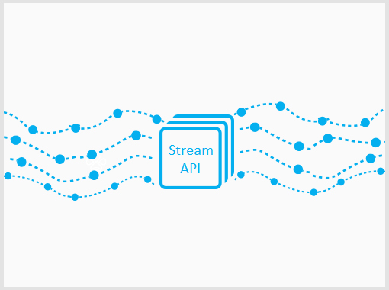

Stream API
Traversing and Querying Collections

Slide 5
The Stream API
Querying a collection in a functional way
Methods are chained together
Example:
Find all unique elements, such that 10 ≤ n ≤ 20 and take the first 2
15
2
15
14
12
15
14

Slide 6
Problem: Take Two
Create a program that:
Reads a sequence of integers
Finds all unique elements, such that 10 ≤ n ≤ 20
Prints only the first 2 elements
15 2 15 14 12
15 14
17 -2 3
17
-2 3
(no output)
Check your solution here: https://judge.softuni.bg/Contests/Practice/Index/465#0

Slide 7
Solution: Take Two – Non Functional
LinkedHashSet<Integer> set = // create set
for (Integer number : numbers) {
if (set.size() >= 2) {
break;
if (10 <= number && number <= 20) {
set.add(number);
}
Check your solution here: https://judge.softuni.bg/Contests/Practice/Index/465#0

Slide 8
Solution: Take Two – Functional
numbers.stream()
.filter(n -> 10 <= n && n <= 20)
.distinct()
.limit(2)
.forEach(n -> print(n));
Check your solution here: https://judge.softuni.bg/Contests/Practice/Index/465#0

Slide 9
Stream<T> Class
Gives access to Stream API functions.
Get an instance through:
A Collection:
An Array:
List<Integer> list = new ArrayList<>();
Stream<Integer> stream = list.stream();
String[] array = new String[10];
Stream<String> stream = Arrays.stream(array);

Slide 10
Stream<T> Class (2)
Gives access to the Stream API.
Get an instance through:
A Hash Map Collection:
HashMap<String, String> map = new HashMap<>();
Stream<Map.Entry<String, String>> entries = map.entrySet().stream();
Stream<String> keys = map.keySet().stream();
Stream<String> keys = map.values().stream();

Slide 11
Function Execution
Each function call creates a new Stream<T> instance
This allows method chaining
List<String> strings = new ArrayList<>();
Stream<String> stringStream = strings.stream();
Stream<Integer> intStream = stringStream.map(s -> s.length());

Slide 12
Function Execution (2)
Execution is "Lazy"
List<Integer>
10
2
5
2
stream()
10
2
5
2
filter(x -> x > 4)
10
2
5
2
map(x -> x * 2)
20
10
forEach(print(x))
20
10

Slide 13

So What is a Stream?
Stream is not a collection and don't store any data
Stream iterates over a collection
Does not modify data it processes
2
5
10
2
5
10

Slide 14

Stream Types and Optionals
Generic and Primitive Streams

Slide 15
Generic Streams
Can be of any type except primitives
List<String> strings = new ArrayList<>();
Stream<String> strStream = strings.stream();
List<Integer> ints = new ArrayList<>();
Stream<Integer> intStream = ints.stream();
List<Object> objects = new ArrayList<>();
Stream<Object> objStream = objects.stream();

Slide 16
Problem: UPPER STRINGS
Read a sequence of strings
Map each to upper case and print them
Use the Stream API
Pesho Gosho Stefan
PESHO GOSHO STEFAN
Soft Uni Rocks
SOFT UNI ROCKS
Check your solution here: https://judge.softuni.bg/Contests/Practice/Index/465#0

Slide 17
Solution: UPPER STRINGS
Scanner scanner = new Scanner(System.in);
List<String> strings = Arrays.asList( scanner
.nextLine()
.split("\\s+"));
strings.stream()
.map(s -> s.toUpperCase())
.forEach(s -> System.out.print(s + " "));
Check your solution here: https://judge.softuni.bg/Contests/Practice/Index/465#0

Slide 18
Optional<T>
Some functions can return Optional<T>
Optional<String> first = elements.stream()
.sorted()
.findFirst();
if (first.isPresent()) {
System.out.println(first.get());
else
System.out.println("No matches.");
Check if optional has value
Gets the value

Slide 19
Problem: First Name
Read a sequence of names
Read a sequence of letters
Of the names that start with one of the letters find the first name (ordered lexicographically)
Rado Plamen Gosho
p r
Plamen
Plamen Gosho Rado
s c
No match
Check your solution here: https://judge.softuni.bg/Contests/Practice/Index/465#0

Slide 20
Solution: First Name
List<String> names = Arrays.asList( scanner.nextLine().split("\\s+"));
HashSet<Character> letters = new HashSet<>();
Stream.of(scanner.nextLine().split("\\s+"))
.map(s -> s.toLowerCase().charAt(0))
.forEach(c -> letters.add(c));
Check your solution here: https://judge.softuni.bg/Contests/Practice/Index/465#0

Slide 21
Solution: First Name (2)
Optional<String> first = names.stream()
.filter(s -> letters.contains(s.toLowerCase().charAt(0)))
.sorted()
.findFirst();
if (first.isPresent())
System.out.println(first.get());
else
System.out.println("No match");
Check your solution here: https://judge.softuni.bg/Contests/Practice/Index/465#0

Slide 22
Primitive Streams
Work efficiently with primitive types
Give access to additional functions
int[] ints = { 1, 2, 3, 4 };
IntStream intStream = IntStream.of(ints);
List<Integer> list = new ArrayList<>();
IntStream mappedIntStream = list.stream()
.mapToInt(n -> Integer.valueOf(n));

Slide 23
Problem: Average of Doubles
Read a sequence of double numbers
Find the average of all elements
Use the Stream API
Round to second digit
3 4 5 6
4.50
3.14 5.2 6.18
4.84
(empty sequenece)
No match
Check your solution here: https://judge.softuni.bg/Contests/Practice/Index/465#0

Slide 24
Solution: Average of Doubles
OptionalDouble average = elements.stream()
.fiter(n -> !n.isEmpty())
.mapToDouble(Double::valueOf)
.average();
if (average.isPresent())
System.out.printf( "%.2f", average.getAsDouble());
else
System.out.println("No match");
Gets the value
Check your solution here: https://judge.softuni.bg/Contests/Practice/Index/465#0

Slide 25

Stream<T> and Primitive Streams
Live Exercises in Class (Lab)

Slide 26


Types of Operations
Intermediate, Terminal

Slide 27
Intermediate Operations
Does not terminate the Stream
List<String> elements = new ArrayList<>();
Collections.addAll(elements, "one", "two");
Stream<String> stream = elements.stream()
.distinct()
.sorted()
.filter(s -> s.length() < 5)
.skip(1)
.limit(1);
All return a new Stream
Allows function chaining

Slide 28
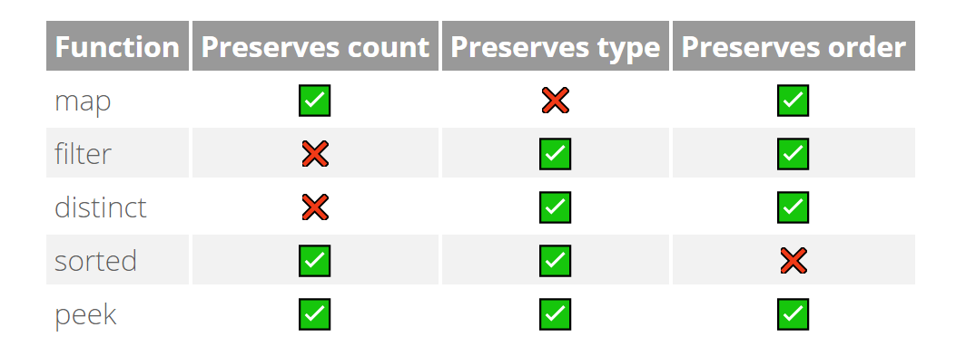
Intermediate Operations (2)
Some of the intermediate operations

Slide 29
Terminal Operations
Terminates the stream
List<String> elements = new ArrayList<>();
Collections.addAll(elements, "one", "two");
elements.stream()
.distinct()
.forEach(s -> System.out.println(s))
Closes the stream

Slide 30
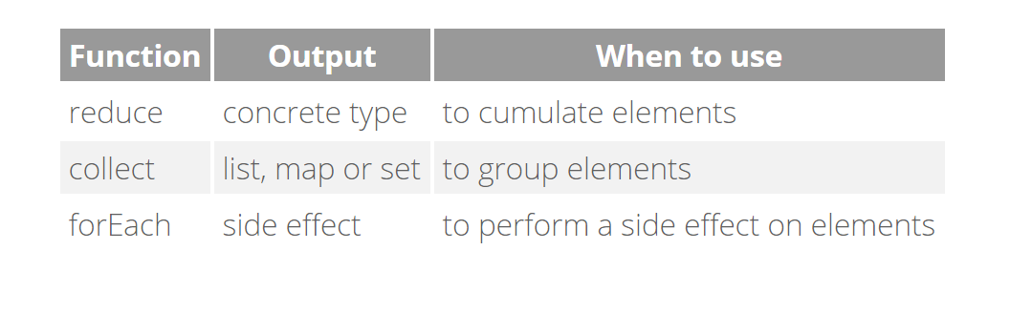
Terminal Operations (2)
Useful terminal operations:

Slide 31

Types of Operations
Map, Filter, Reduce

Slide 32
Map, Filter, Reduce
Common pattern in data querying
List<String>
"10"
"2"
"5"
"6"
.mapToInt(Integer::valueOf())
10
2
5
6
.filter(x -> x > 4)
10
5
6
10
5
6
21
.reduce((x, y) -> x + y)
15

Slide 33
Map Operations
Transform the objects in the stream
Stream<String> strStream =
Stream.of("1", "2", "3");
Stream<Integer> numStream = strStream.map(Integer::valueOf);
Transforms the stream

Slide 34
Filter Operations
Filters objects by a given predicate
Stream<String> strStream = Stream.of("one", "two", "three")
.filter(s -> s.length() > 3);
Preserves strings longer that 3

Slide 35
Reduce Operations
Check for a given condition:
Any element matches:
All elements match:
None of the elements match:
Short circuit operations
Short circuit operations
boolean any = stream1.anyMatch(x -> x % 2 == 0);
boolean all = stream2.anyMatch(x -> x % 2 == 0);
boolean none = stream3.noneMatch(x -> x % 2 == 0);

Slide 36
Find Reductions
Find an element:
Gets the first element of the stream:
Gets any element of the stream:
Optional<Integer> first = list.stream() .findFirst();
Optional<Integer> first = list.stream() .findAny();

Slide 37
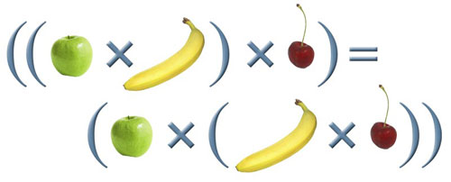
General Reduction
Applies а given lambda:
Consider associativity:
Optional<Integer> first = list.stream() .reduce((x, y) -> x + y);
r(a, r(b, c)) should be equal to r(r(a, b), c)

Slide 38
Problem: Min Even Number
Read a sequence of numbers
Find the min of all even numbers
Use the Stream API
1 2 3 4 5 6
2.00
3.14 -2.00 1.33
-2.00
(empty list)
No match
Check your solution here: https://judge.softuni.bg/Contests/Practice/Index/465#0

Slide 39
Solution: Min Even Number
Optional<Double> min = Arrays.stream( scanner.nextLine().split("\\s+"))
.filter(n -> !n.isEmpty())
.map(Double::valueOf)
.filter(n -> n % 2 == 0)
.min(Double::compare);
Check your solution here: https://judge.softuni.bg/Contests/Practice/Index/465#0

Slide 40
Problem: Find and Sum Integers
Read a sequence of elements
Find the sum of all integers
Use the Stream API
Sum 3 and 4
7
Sum -3 and -4
-7
Sum three and four
No match
Check your solution here: https://judge.softuni.bg/Contests/Practice/Index/465#0

Slide 41
Solution: Find and Sum Integers
Optional<Integer> sumOfIntsGT20 = Arrays.stream( scanner.nextLine().split("\\s+"))
.filter(x -> isNumber(x))
.map(Integer::valueOf)
.reduce((x1, x2) -> x1 + x2);
Implement boolean method
Check your solution here: https://judge.softuni.bg/Contests/Practice/Index/465#0

Slide 42
Sorting
Sort by passing a comparator as lambda:
List<Integer> numbers = new ArrayList<>();
Collections.addAll(numbers, 7, 6, 3, 4, 5);
numbers.stream()
.sorted((x1, x2) -> Integer.compare(x1, x2)) .forEach(System.out::println);
(x2, x1) for descending order

Slide 43


Streams on HashMaps
Creating a Stream over a HashMap

Slide 44
Creating the Stream
Use any dimension of the Hash Map:
Stream over the Entry set:
Stream over the Key set:
Stream over the Value set:
Stream<Map.Entry<String, String>> entries = map.entrySet().stream();
Stream<String> keys = map.keySet().stream();
Stream<String> keys = map.values().stream();

Slide 45
Problem: Map Districts
You are given population count of districts in different cities
Print all cities with population greater than a given bound
Print top 5 districts for a given city
Sort cities and districts by descending population
Pld:9 Pld:13 Has:7 Sof:20 Sof:10 Sof:15
10
Population greater than 10
Sof: 20 15 10
Pld: 13 9
Check your solution here: https://judge.softuni.bg/Contests/

Slide 46
Solution: Map Districts
HashMap<String, List<Integer>> cities = // init map
// TODO: populate hash map
cities.entrySet().stream()
.filter(getFilterByPopulationPredicate(bound))
.sorted(getSortByDescendingPopulationComparator())
.forEach(getPrintMapEntryConsumer());
Check your solution here: https://judge.softuni.bg/Contests/Practice/Index/465#0

Slide 47
Solution: Map Districts (2)
// Filter by Population Predicate
return kv -> (kv.getValue().stream()
.mapToInt(Integer::valueOf)
.sum()) >= bound;
// Sort by Descending Population Comparator
return (kv1, kv2) -> Integer.compare(
kv2.getValue().stream().mapToInt(Integer::valueOf).sum(),
kv1.getValue().stream().mapToInt(Integer::valueOf).sum()
);
Check your solution here: https://judge.softuni.bg/Contests/Practice/Index/465#0

Slide 48
Solution: Map Districts (3)
// Print Map Entry Consumer
return kv -> {
System.out.print(kv.getKey() + ": ");
kv.getValue().stream()
.sorted((s1, s2) -> s2.compareTo(s1))
.limit(5)
.forEach(dp -> System.out.print(dp + " "));
System.out.println();
};
Check your solution here: https://judge.softuni.bg/Contests/Practice/Index/465#0

Slide 49





Collectors
Materializing a Stream

Slide 50

Collectors
Collecting a Stream into a list:
You can collect streams into different collections:
Arrays, Sets, HashMaps, etc.
String[] strings = { "22", "11", "13" };
List<Integer> numbers = Arrays.stream(strings)
.map(Integer::valueOf)
.collect(Collectors.toList());

Slide 51
Problem: Bounded Numbers
Read a lower and upper bound
Read a sequence of numbers
Print all numbers, such that lower bound ≤ n ≤ upper bound
5 7
1 2 3 4 5 6 7 8 9
7 5
9 5 7 2 6 8
5 6 7
5 7 6
Check your solution here: https://judge.softuni.bg/Contests/Practice/Index/465#0

Slide 52
Solution: Bounded Numbers
Scanner scanner = new Scanner(System.in);
List<Integer> bounds = Arrays.stream(scanner.nextLine().split("\\s+"))
.map(Integer::valueOf)
.collect(Collectors.toList());
// continues…
Check your solution here: https://judge.softuni.bg/Contests/Practice/Index/465#0

Slide 53
Solution: Bounded Numbers (2)
List<Integer> numbers = Arrays.stream(scanner.nextLine().split("\\s+"))
.map(Integer::valueOf)
.filter(x -> Collections.min(bounds) <= x && x <= Collections.max(bounds))
.collect(Collectors.toList());
Check your solution here: https://judge.softuni.bg/Contests/Practice/Index/465#0

Slide 54





Types of Operations
Live Exercises in Class (Lab)

Slide 55
Summary
Stream API is used to traverse and query collections
Streams have "lazy" execution
Streams can be Generic or Primitive
Types of Operations
Intermediate, Terminal
Mapping, Filtering and Reducing
Sorting
Streams can be collected into a collection

Slide 56









Stream API
https://softuni.bg/courses/programming-fundamentals

Slide 57
License
This course (slides, examples, demos, videos, homework, etc.) is licensed under the "Creative Commons Attribution-NonCommercial-ShareAlike 4.0 International" license
Attribution: this work may contain portions from
"Fundamentals of Computer Programming with Java" book by Svetlin Nakov & Co. under CC-BY-SA license
"C# Part I" course by Telerik Academy under CC-BY-NC-SA license
"C# Part II" course by Telerik Academy under CC-BY-NC-SA license

Slide 58






Free Trainings @ Software University
Software University Foundation – softuni.org
Software University – High-Quality Education, Profession and Job for Software Developers
softuni.bg
Software University @ Facebook
facebook.com/SoftwareUniversity
Software University @ YouTube
youtube.com/SoftwareUniversity
Software University Forums – forum.softuni.bg

